Slide 1
Transaction

Slide 2
Chapters 15: Transaction Management
Transaction (Chapter 15)
Transaction Concept
Transaction State
Concurrent Executions
Serializability
Recoverability
Testing for Serializability

Slide 3
Transaction Concept
A transaction is a unit of program execution that accesses and possibly updates various data items.
E.g. transaction to transfer €50 from account A to account B:
1. read_from_acoount(A)
2. A := A – 50
3. write_to_account(A)
4. read_from_accont(B)
5. B := B + 50
6. write_to_account(B)
Two main issues to deal with:
Failures of various kinds, such as hardware failures and system crashes
Concurrent execution of multiple transactions

Slide 4
Transaction ACID properties
E.g. transaction to transfer €50 from account A to account B:
1. read_from_acoount(A)
2. A := A – 50
3. write_to_account(A)
4. read_from_accont(B)
5. B := B + 50
6. write_to_account(B)
Atomicity requirement
if the transaction fails after step 3 and before step 6, money will be “lost” leading to an inconsistent database state
Failure could be due to software or hardware
the system should ensure that updates of a partially executed transaction are not reflected in the database
All or nothing, regarding the execution of the transaction
Durability requirement — once the user has been notified of transaction has completion, the updates must persist in the database even if there are software or hardware failures.

Slide 5
Transaction ACID properties (Cont.)
Transaction to transfer €50 from account A to account B:
1. read_from_acoount(A)
2. A := A – 50
3. write_to_account(A)
4. read_from_accont(B)
5. B := B + 50
6. write_to_account(B)
Consistency requirement in above example:
the sum of A and B is unchanged by the execution of the transaction
In general, consistency requirements include
Explicitly specified integrity constraints such as primary keys and foreign keys
Implicit integrity constraints
e.g. sum of balances of all accounts, minus sum of loan amounts must equal value of cash-in-hand
A transaction must see a consistent database and must leave a consistent database
During transaction execution the database may be temporarily inconsistent.
Constraints to be verified only at the end of the transaction

Slide 6
Transaction ACID properties (Cont.)
Isolation requirement — if between steps 3 and 6, another transaction T2 is allowed to access the partially updated database, it will see an inconsistent database (the sum A + B will be less than it should be). T1 T2
1. read(A)
2. A := A – 50
3. write(A) read(A), read(B), print(A+B)
4. read(B)
5. B := B + 50
6. write(B
Isolation can be ensured trivially by running transactions serially
that is, one after the other.
However, executing multiple transactions concurrently has significant benefits, as we will see later.

Slide 7
ACID Properties - Summary
A transaction is a unit of program execution that accesses and possibly updates various data items.To preserve the integrity of data the database system must ensure:
Atomicity Either all operations of the transaction are properly reflected in the database or none are.
Consistency Execution of a (single) transaction preserves the consistency of the database.
Isolation Although multiple transactions may execute concurrently, each transaction must be unaware of other concurrently executing transactions. Intermediate transaction results must be hidden from other concurrently executed transactions.
That is, for every pair of transactions T_{i} and T_{j}, it appears to T_{i} that either T_{j}, finished execution before T_{i} started, or T_{j} started execution after T_{i} finished.
Durability. After a transaction completes successfully, the changes it has made to the database persist, even if there are system failures.

Slide 8
Non-ACID Transactions
There are application domains where ACID properties are not necessarily desired or, most likely, not always possible.
This is the case of so-called long-duration transactions
Suppose that a transaction takes a lot of time
In this case it is unlikely that isolation can/should be guaranteed
E.g. Consider a transaction of booking a hotel and a flight
Without Isolation, Atomicity may be compromised
Consistency and Durability should be preserved
Usual solution for long-duration transaction is to define compensation action – what to do if later the transaction fails
In (centralized) databases long-duration transactions are usually not considered.
But these are more and more important, specially in the context of the Web.

Slide 9
Transaction State
Active – the initial state; the transaction stays in this state while it is executing
Partially committed – after the final statement has been executed.
Failed – after the discovery that normal execution can no longer proceed.
Aborted – after the transaction has been rolled back and the database restored to its state prior to the start of the transaction. Two options after it has been aborted:
restart the transaction
can be done only if no internal logical error
kill the transaction
Committed – after successful completion.
To guarantee atomicity, external observable action should all be performed (in order) after the transaction is committed.

Slide 10
Committed Transactions
A committed transaction that has performed updates transforms the database into anew consistent state, which must persist even if there is a system failure.
It cannot undo its effects by aborting it
The only way to undo the effects of a committed transaction is to execute a compensating transaction.

Slide 11
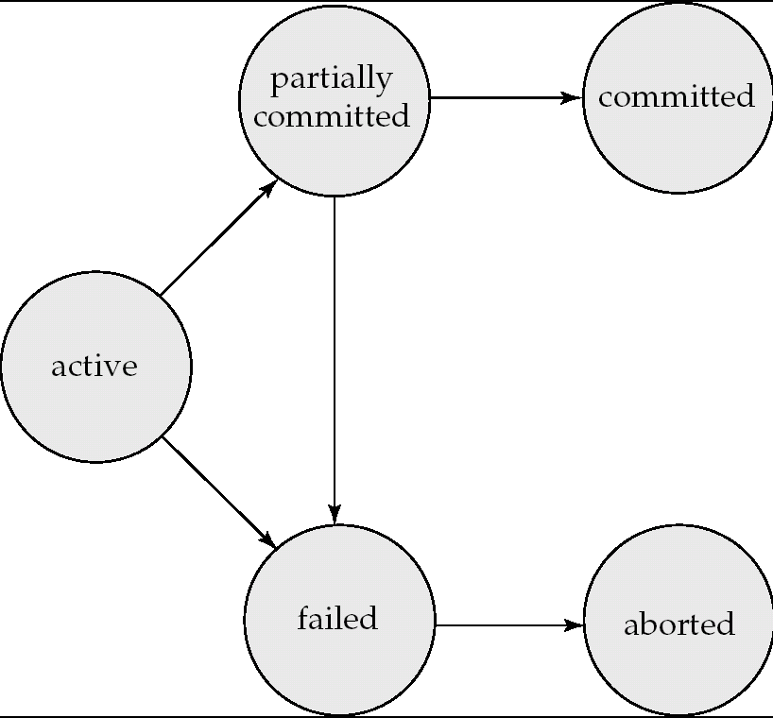
Transaction State (Cont.)

Slide 12
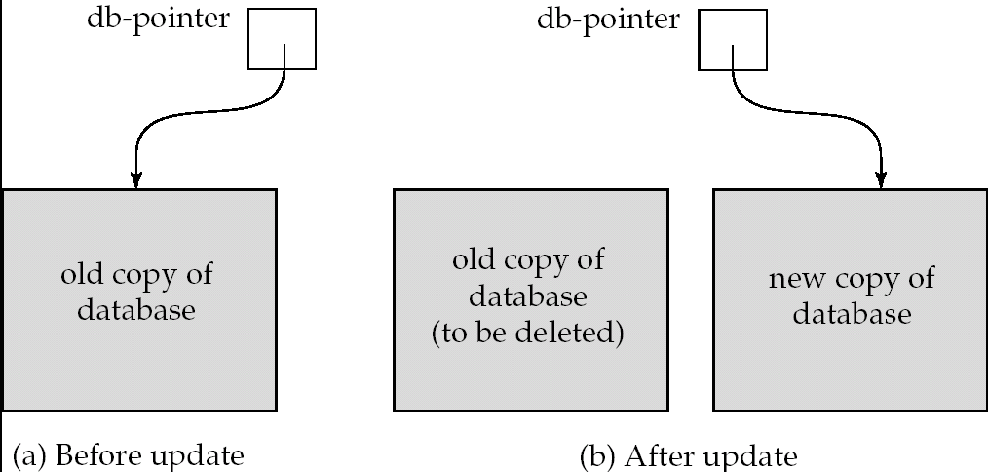
Implementation of Atomicity and Durability
The recovery-management component of a database system implements the support for atomicity and durability.
E.g. the shadow-database scheme:
all updates are made on a shadow copy of the database
db_pointer is made to point to the updated shadow copy after
the transaction reaches partial commit and
all updated pages have been flushed to disk.

Slide 13
Implementation of Atomicity and Durability
The recovery-management component of a database system implements the support for atomicity and durability.
E.g. the shadow-database scheme:
all updates are made on a shadow copy of the database
db_pointer is made to point to the updated shadow copy after
the transaction reaches partial commit and
after the operating system has written all the pages to disk

Slide 14
Implementation of Atomicity and Durability (Cont.)
db_pointer always points to the current consistent copy of the database.
In case transaction fails, old consistent copy pointed to by db_pointer can be used, and the shadow copy can be deleted.
The shadow-database scheme:
Assumes that only one transaction is active at a time.
Assumes disks do not fail
Useful for text editors, but
extremely inefficient for large databases(!)
Variant called shadow paging reduces copying of data, but is still not practical for large databases
Does not handle concurrent transactions
Other implementations of atomicity and durability are possible, e.g. by using logs.
Log-based recovery will be addressed later.

Slide 15
Schedules
Schedule – a sequences of instructions that specify the chronological order in which instructions of concurrent transactions are executed
a schedule for a set of transactions must consist of all instructions of those transactions
must preserve the order in which the instructions appear in each individual transaction.
A transaction that successfully completes its execution will have a commit instructions as the last statement
by default transaction assumed to execute commit instruction as its last step
A transaction that fails to successfully complete its execution will have an abort instruction as the last statement
The goal is to find schedules that preserve the consistency.

Slide 16
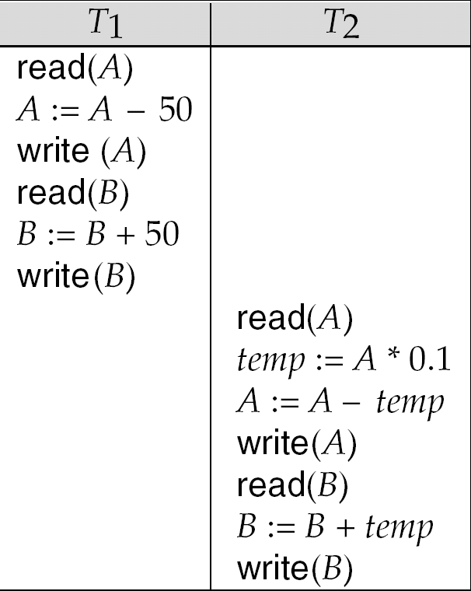
Example Schedule 1
Let T₁ transfer €50 from A to B, and T₂ transfer 10% of the balance from A to B.
A serial schedule in which T₁ is followed by T₂ :

Slide 17
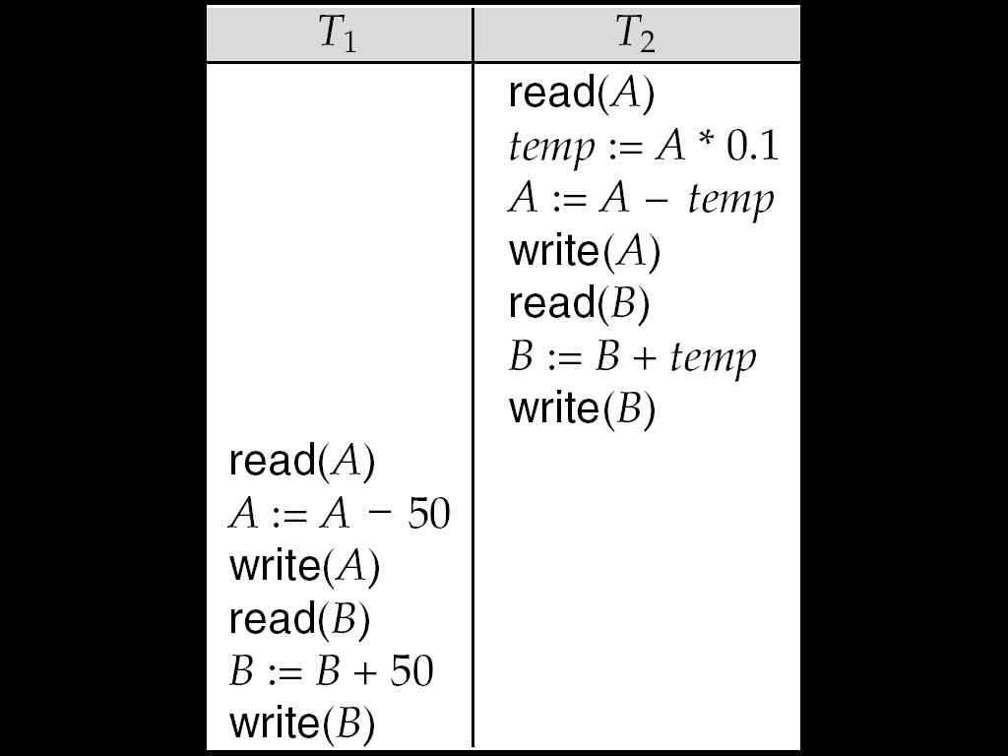
Example Schedule 2
A serial schedule where T₂ is followed by T₁

Slide 18
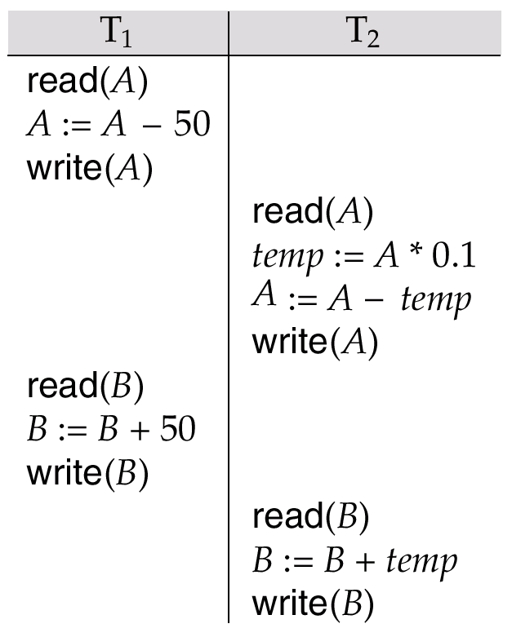
Example Schedule 3
Let T₁ and T₂ be the transactions defined previously. The following schedule is not a serial schedule, but it is equivalent to Schedule 1.
In Schedules 1, 2 and 3, the sum A + B is preserved.

Slide 19
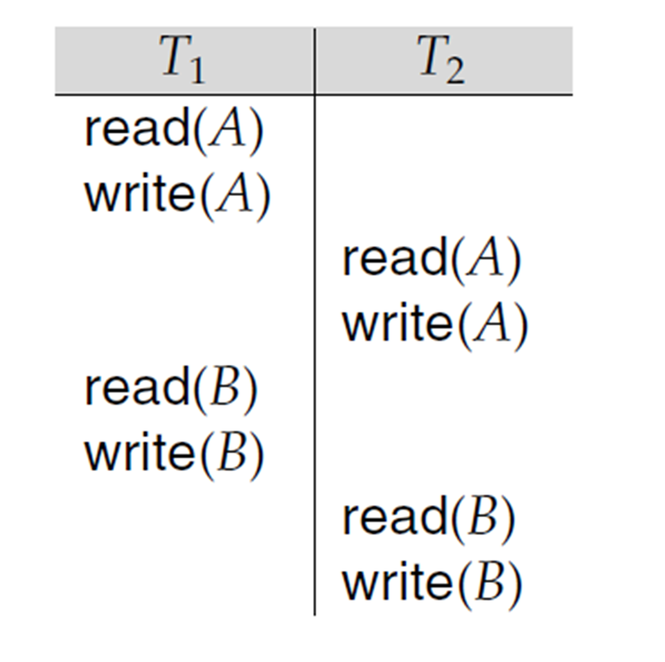

Slide 20
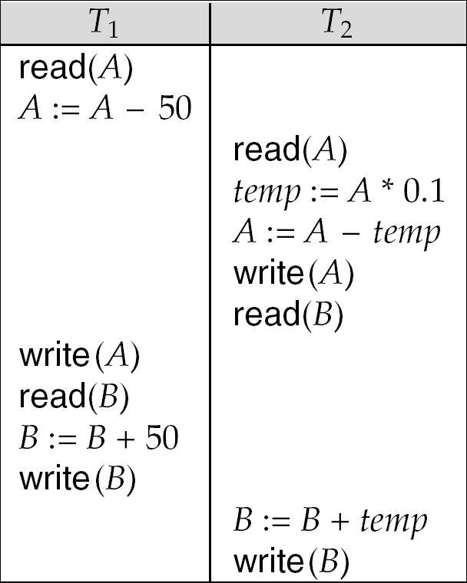
Example Schedule 4
The following concurrent schedule does not preserve the value of (A + B ).

Slide 21
Serializability
Goal : Deal with concurrent schedules that are equivalent to some serial execution:
Basic Assumption – Each transaction preserves database consistency.
Thus serial execution of a set of transactions preserves database consistency.
A (possibly concurrent) schedule is serializable if it is equivalent to a serial schedule. Different forms of schedule equivalence give rise to the notions of:
1. conflict serializability
2. view serializability
Simplified view of transactions
We ignore operations other than read and write instructions
We assume that transactions may perform arbitrary computations on data in local buffers in between reads and writes.
Our simplified schedules consist of only read and write instructions.

Slide 22
Conflicting Instructions
Instructions l_{i} and l_{j} of transactions T_{i} and T_{j} respectively, conflict if and only if there exists some item Q accessed by both l_{i} and l_{j}, and at least one of these instructions wrote Q.
1. l_{i} = read(Q), l_{j} = read(Q). l_{i} and l_{j} don’t conflict. 2. l_{i} = read(Q), l_{j} = write(Q). They conflict. 3. l_{i} = write(Q), l_{j} = read(Q). They conflict 4. l_{i} = write(Q), l_{j} = write(Q). They conflict
Intuitively, a conflict between l_{i} and l_{j} forces an order between them.
If l_{i} and l_{j} are consecutive in a schedule and they do not conflict, their results would remain the same even if they had been interchanged in the schedule.

Slide 23


Slide 24
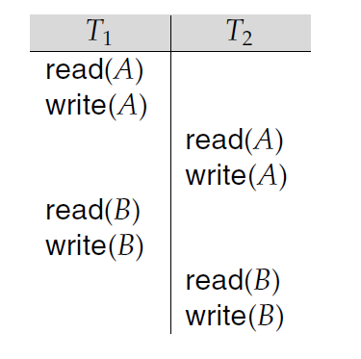

Slide 26
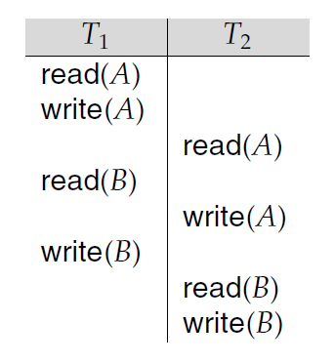

Slide 27
Continue to Swap Nonconflicting Instructions
• Swap the read(B) instruction of T1
with the read(A) instruction of T2
• Swap the write(B) instruction of T1
with the write(A) instruction of T2.
• Swap the write(B) instruction of T1
with the read(A) instruction of T2.

Slide 29
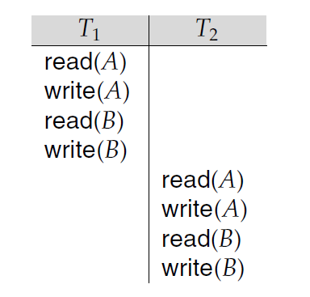
Conflict Equivalent.

Slide 30
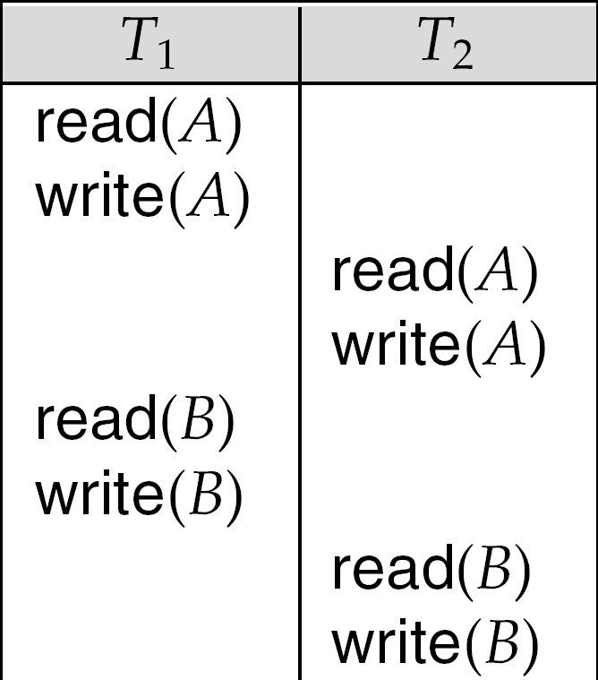
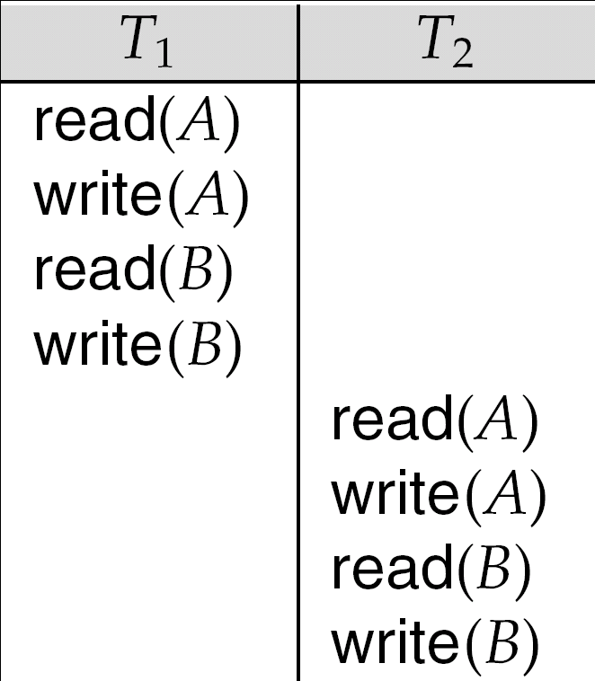
Conflict Serializability
If a schedule S can be transformed into a schedule S´ by a series of swaps of non-conflicting instructions, we say that S and S´ are conflict equivalent.
We say that a schedule S is conflict serializable if it is conflict equivalent to a serial schedule
Schedule 3 can be transformed into Schedule 6, a serial schedule where T₂ follows T₁, by series of swaps of non-conflicting instructions. Therefore it is conflict serializable.
Schedule 3
Schedule 6

Slide 31
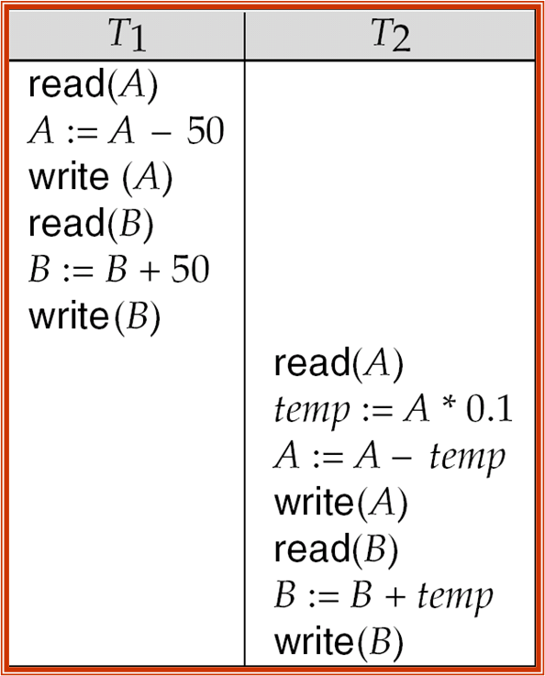
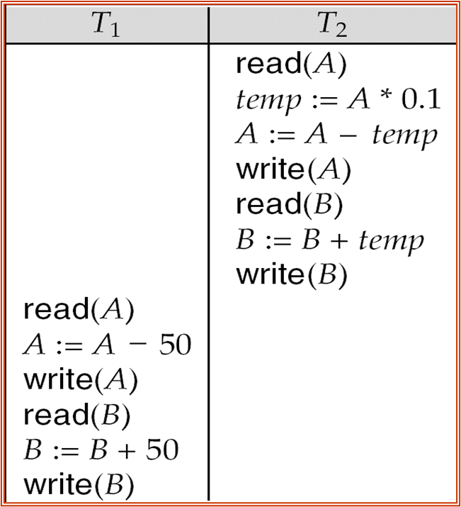
Schedule 1 is not conflict equivalent to Schedule 2
Schedule 1 Schedule 2

Slide 32
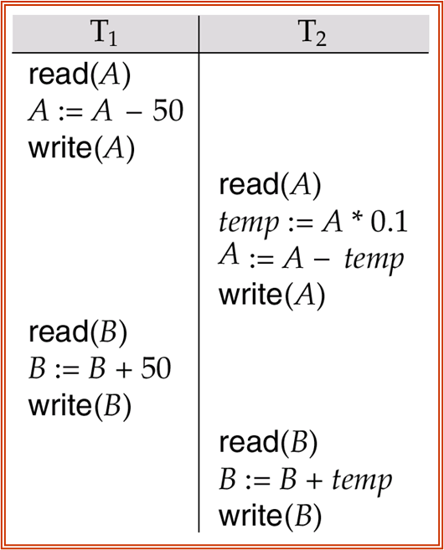
Schedule 1 is conflict equivalent to Schedule 3 read(B) and write(B) instruction of T1 >swapped
read(A) and write(A) instruction of T2.
Schedule 1 Schedule 3

Slide 33
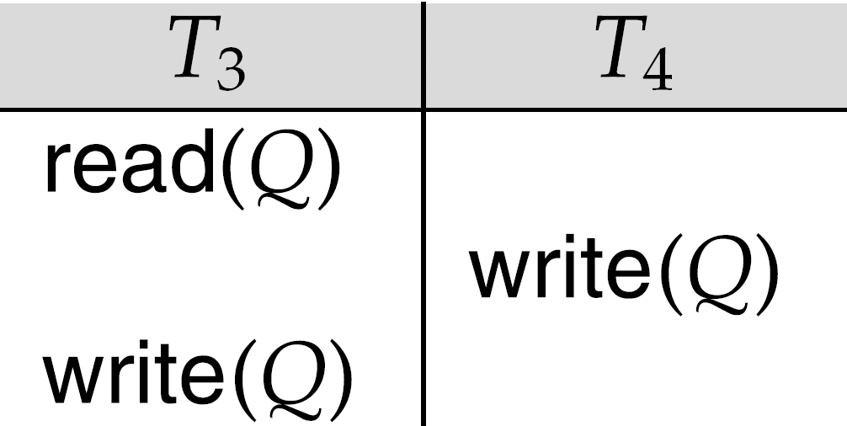
Conflict Serializability (Cont.)
Example of a schedule-7 that is not conflict serializable:
We are unable to swap instructions in the above schedule to obtain either the serial schedule < T₃, T₄ >, or the serial schedule < T₄, T₃ >.

Slide 34
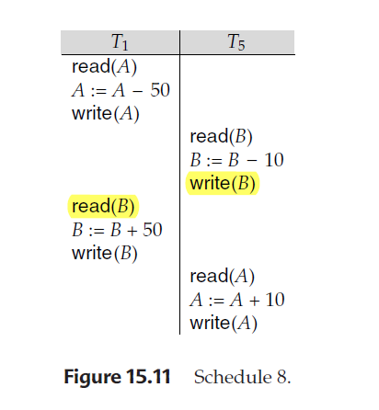
Schedules that produce the same outcome
But that are not conflict equivalent.

Slide 35
View Serializability
Sometimes it is possible to serialize schedules that are not conflict serializable
View serializability provides a weaker and still consistency preserving notion of serialization
Let S and S´ be two schedules with the same set of transactions. S and S´ are view equivalent if the following three conditions are met, for each data item Q,
If in schedule S, transaction T_{i} reads the initial value of Q, then in schedule S’ also transaction T_{i} must read the initial value of Q.
If in schedule S transaction T_{i} executes read(Q), and that value was produced by transaction T_{j} (if any), then in schedule S’ also transaction T_{i} must read the value of Q that was produced by the same write(Q) operation of transaction T_{j} .
The transaction (if any) that performs the final write(Q) operation in schedule S must also perform the final write(Q) operation in schedule S’.

Slide 36
Schedule 1 is not VIEW equivalent to Schedule 2
Schedule 1 Schedule 2

Slide 37
Schedule 1 is conflict equivalent to Schedule 3 read(B) and write(B) instruction of T1 >swapped
read(A) and write(A) instruction of T2.
Schedule 1 Schedule 3

Slide 38
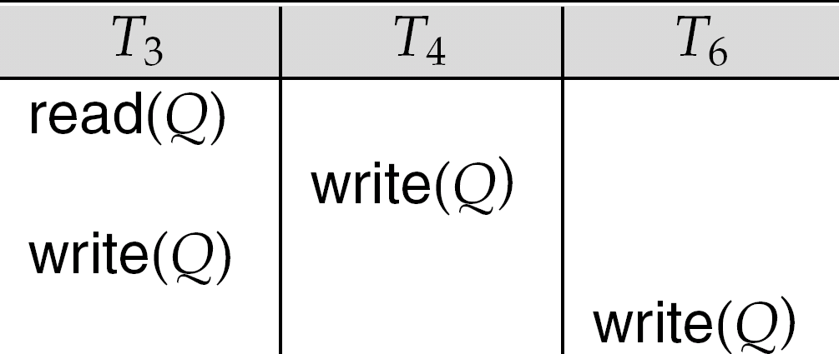
View Serializability (Cont.)
A schedule S is view serializable if it is view equivalent to a serial schedule.
Every conflict serializable schedule is also view serializable.
Below is a schedule which is view-serializable but not conflict serializable.
It is equivalent to either <T3,T4,T6> or <T4,T3,T6>
Every view serializable schedule that is not conflict serializable has blind writes.

